Slide 1
WEBINAR
GETTING
BUY-IN
JUNE 22, 2023 | 2–3 p.m. ET

Slide 2
Housekeeping
Introductions
Polls
Presentation
Q&A

Slide 3
HOUSEKEEPING
Notes:
Add your comments and questions to the chat as we go!
This webinar is being recorded.

Slide 4
INTRODUCTIONS
(AND A LITTLE MORE ABOUT US)

Slide 5
GREENERU IN A NUTSHELL
VISION
GreenerU envisions educational and community institutions leading the world
in mitigating climate change.
MISSION
Our mission is to help our clients achieve climate neutrality and sustainable operations.
THE NUTSHELL
GreenerU helps institutions navigate the organizational, operational, and infrastructural changes required to reach climate neutrality.

Slide 6
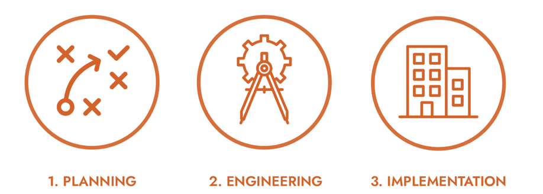
OUR PATH TO CLIMATE NEUTRALITY
outlining and developing a path to meeting your climate goals
developing detailed building energy and greenhouse gas emissions reduction measures
efficiency, electrification, and decarbonization measures through the built environment
Notes:
Additional notes:
We’re a small firm that’s worked almost exclusively in the higher education space.
We are one of the only firms in the country with this particular integrated services model, with our work in climate action planning informed in part by engineered solutions and construction.
As a small firm, we are nimble—fewer organizational layers, more internal communication.
We will all be familiar with your team and get to know you. We are excited to draw out your expertise.
Not a typical consulting firm.
Not a typical engineering firm.
The GreenerU Way: passion, excellence, supportive, and transparent—we place a high value on inclusion and a caring company culture.
We think these traits radiate out in the way our clients experience us, too.

Slide 7
NORM YOUNG
Senior facilities officer at University of Hartford
Strategic and capital planning
Operations and project management
Leader at APPA
APPA International Board of Directors
VP of Information and Communication
Chapter and Regional President
Norm Young
Strategic Advisor

Slide 8
POLLS

Slide 9
OVERVIEW
This presentation is about selling ideas, services, products, etc., through discovery and effective communication, with a focus on benefits (the why).
a.k.a.
The ability to communicate an idea effectively is as important as the idea itself.

Slide 10
AGENDA
Discovery and the sales process
Background information
Decision makers, influencers, champions
Interviewing
The pitch: getting to yes
Features, functions, and benefits
Effective communication
Presentations

Slide 11
DISCOVERY
Background information
Organizational and departmental history
Political landscape
Sustainability goals and initiatives
Strategic and master plans
What does this tell you?

Slide 12
DISCOVERY
Decision-makers
Influencers
Champions
Who are they?
Why is this important?
Interviewing

Slide 13
INTERVIEWING TECHNIQUES
Why is this important in the sales process?
What kind of questions?
Open ended questions: who, what, why, how
Why?...five times

Slide 14
PRE-MEETING PLANNER
Who’s attending
Where is the meeting (office, conference room…)
What are the topics to cover
What are the ten questions you want to ask
Who is going to ask them

Slide 15
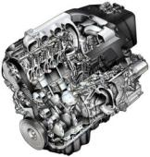
FEATURES, FUNCTIONS, AND BENEFITS
What is a feature?
What it is
What is a function?
What it does
What is a benefit?
What it means to someone

Slide 16
FEATURES, FUNCTIONS, AND BENEFITS
Common mistakes:
“Selling” features and functions
Why doesn’t this work?
People “buy” benefits
Common to “getting to yes”
Clearly identify all the benefits in their terms
Make sure that you have benefits for all the constituent groups
Make the connection of what it means to them—the “so what?” factor

Slide 17
EFFECTIVE “SPEAK”
Finance vs. engineering
Buildings as assets
Investment vs. funding
Sustainable use of assets
Investments as project selection

Slide 18
THE SEVEN DEADLY SINS
Not practicing—cardinal deadly!
Umms, ahhs
Not walking around
Reading slides…ouch!
Too many words
6-point font
No stories

Slide 19
GETTING ATTENTION, KEEPING INTEREST
Body position
Facial expression
Intonation
Graphics non-flying
Stories

Slide 20
Q&A

