Slide 1
NAVIGATING THE STEPS TO CLIMATE NEUTRALITY:
PRIORITIZING AND ALIGNING
JULY 16, 2021
1–2:30 P.M. ET

Slide 2
PRIORITIZING AND ALIGNING WITH INSTITUTIONAL GOALS

Slide 3
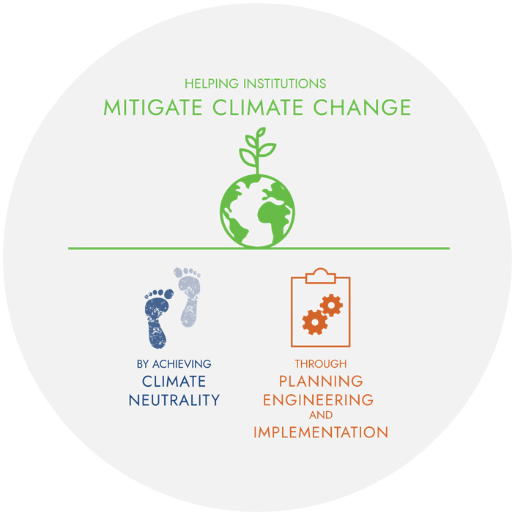
GREENERU IN A NUTSHELL
VISION
GreenerU envisions educational and community institutions leading the world in mitigating climate change.
MISSION
Our mission is to help our clients achieve climate neutrality and sustainable operations.
GreenerU helps institutions navigate the organizational, operational, and infrastructure changes required to reach climate neutrality.

Slide 4
NAVIGATING TO CLIMATE NEUTRALITY
CO₂
1.
2.
3.
Ø
PLAN
ENGINEER
IMPLEMENT
ENGINEERING DESIGNS
STARS
INSTITUTIONAL PLANS
ENERGY
SAVINGS
RENEWABLE ENERGY STUDIES
HEAT
PUMPS
CONTRACTS
COMMISSIONING
BASELINE ASSESSMENT
ACADEMIA
UTILITY INCENTIVES
ELECTRIFICATION
LOW-TEMP
HOT WATER
CONSTRUCTION
PROCUREMENT
SIMAP
STAKEHOLDER ENGAGEMENT
FINANCING
INVESTIGATION
WATER
MANAGEMENT
LED LIGHTING
PROJECT MANAGEMENT
M&V
CLIMATE Ø TARGET
CLIMATE JUSTICE
TAX INCENTIVES
PERMITS
VARIABLE
FREQUENCY
DRIVES
ZERO-CARBON FLEET
CONTROLS
DIVESTMENT
REVOLVING FUND
SOLAR
CARBON SINKS
EFFICIENT HVAC
OFFSETS
CLIMATE ACTION PLAN
LEED
CERTIFICATION
RESILIENCY
WIND
PERMITS

Slide 5
CLIMATE NEUTRALITY IN THREE STEPS
GreenerU provides a broad range of program- and project-management services to help institutions achieve climate neutrality:
CO₂
1.
2.
3.
Ø
PLAN
ENGINEER
IMPLEMENT
data gathering and baselining
strategic planning facilitation
stakeholder engagement
engineering design
feasibility assessments
financing navigation
project management
efficient lighting design
ECM installations
mechanical infrastructure projects
measurement and verification

Slide 6
STEP ONE: PLAN
1.
PLAN
GATHER BASELINE DATA
Measure Scopes 1, 2, and 3 greenhouse gas emissions
Gather STARS-related sustainability metrics
GET BUY-IN
Align and integrate institutional priorities
Activate institution-wide support
Evaluate institutional capacity
CREATE ROADMAP
Set climate neutrality target
Establish institutional goals and strategies
Develop implementable workplan
Notes:
LISA (JEN)
GreenerU’s change management team has been seeing (and winning) more requests for climate action planning within the last two years. CAPs typically include carbon or climate neutrality targets and varying levels of detailed plans and benchmarks to get there.
We’ve been working with several clients on either initial or renewed climate action planning efforts—Umass Amherst, Umass Medical School, Portland Community College, Concord Free Public Library, and more. (Swarthmore?)
These planning efforts have some of the same basic elements to them:
Gathering baseline data through STARS and measuring Scopes 1, 2, and 3 emissions
Developing institution-wide support through stakeholder engagement
Addressing policy gaps and internal capacity issues
Aligning climate neutrality planning with other institutional plans
Finally, coming up with an implementable plan
But there are many elements behind the scenes that are not at all straightforward. It’s important to remember that our clients are also mission-driven, and that their educational mission and additional values (justice, equity, diversity, serving low-income communities, and so on) must be integrated into this process, or else these efforts won’t ultimately lead to sustainable operations.
Our goal for the planning phase is to help institutions feel empowered and informed so that they can embark on the next phase: engineering.

Slide 7
SO WHY AREN’T WE THERE YET?
COST | INERTIA | LACK OF PRIORITY
“It’s too expensive” “We already have too much debt” | “This is how we’ve always done things” “We don’t have a good process to tackle projects like these” | “There’s not enough institutional support” “There are more urgent problems” “We don’t have the bandwidth”
↓ | ↓ | ↓
FINANCING OPTIONS ENERGY SAVINGS INCENTIVE PROGRAMS GREEN REVOLVING LOAN FUNDS | PLANNING OUTSOURCING TRAINING LEADERSHIP PROGRAMMATIC APPROACH | ENGAGING STAKEHOLDERS SUPPORT INSTITUTIONAL PLANS HIGHLIGHTING OTHER BENEFITS
Notes:
There are all kinds of road blocks to achieving climate neutrality that don’t have simple or technical solutions.
These are just a few themes we hear from our clients.
Thus, there is an important role for GreenerU to play here—that of helping our clients navigate all sorts of challenging territory, from politics to policies to finding funding.

Slide 8
PRIORITIZING CLIMATE NEUTRALITY
THREE TIPS:
1. ENGAGE STAKEHOLDERS
2. SUPPORT INSTITUTIONAL DIRECTION
3. CREATE OTHER BENEFITS

Slide 9
PRIORITIZATION: WHAT AND WHY
1. ENGAGE STAKEHOLDERS
(JUNE 4 WEBINAR)
1a. Engage the leadership beyond the president
1b. Lean on a diverse group for advocacy
1c. Celebrate and keep the message simple
2a. Outline how carbon neutrality supports the mission of the institution
2b. Identify how past infrastructure projects were prioritized and implemented
2c. Link carbon-neutral operations directly with capital planning needs
3a. Align with deferred maintenance
3b. Support local, state, and national directives
3c. Show a business case beyond ROI
2. SUPPORT INSTITUTIONAL DIRECTIVES
3. CREATE OTHER BENEFITS
Notes:
The first strategy had its own webinar on June 4th. The main outcomes were (1) leadership is beyond president, (2) have a diverse advocacy with a simple message, and 3) celebrate and keep the message simple.
The other two topics we will dive into today. I will give a short overview with examples and we will then talk about our methods and learned lessons in the break out rooms.
Climate neutrality needs to support the overall mission, understand how change happens, and create link to infrastructure change on campus.
Climate neutrality for an institution can seem unimportant on a global scale and can feel overwhelming on a specific campus, so it needs to fit into a campus climate action narrative and align with the campus ethos.

Slide 10
1. ENGAGE STAKEHOLDERS
$
$
$
1A. ENGAGE LEADERSHIP BEYOND THE PRESIDENT
1B. SUPPORT DIVERSE ADVOCACY WITH A CLEAR MESSAGE — AND LISTEN AND ALIGN
1C. CELEBRATE AND SAY THANK YOU; KEEP THE MESSAGE SIMPLE
* From GreenerU’s June 4 webinar: engaging leadership
Notes:
Engage the leadership beyond the president
Leadership exists on all levels—institutions are seldom hierarchies.
The President typically reports to the Board of Trustees or Overseers or Cabinet. Whatever it’s called, their usual charter is twofold: ensuring that the institution is meeting its mission and being good stewards of the institution’s finances.
Faculty and your VP of Finance are also important to have at the decision-making table.
Maybe most importantly, though, is the student body - who can often have the most influence over institutional decision-making
Support diverse advocacy with a clear message
You want to form a group, a steering committee, an organization, something that brings to the table representation from all different parts of your institution. When you’ve taken a look at how your institution’s leadership structure works, try to map out who all the stakeholders are and create “chairs” on this steering committee that you aim to fill with someone from these different groups.
Celebrate and keep the message simple
Your institution has unquestionably had some climate wins over the years. Find out what they are! Celebrate those, either formally or informally, and say thank you—you would not believe how effective saying thank you is in developing alliances.

Slide 11
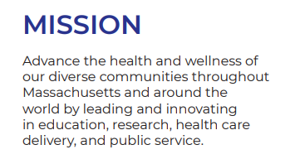
2. SUPPORT INSTITUTIONAL DIRECTION
Case study:
Supporting institutional mission
2A. OUTLINE HOW CARBON NEUTRALITY SUPPORTS THE MISSION OF THE INSTITUTION
Notes:
UMass Medical School collaborated with the other state schools to create a board-level policy that each institution report to annually. In addition, as the medical school does not have specific research or request for addressing sustainability within its operations as a cost saving measure beyond being a state entity, they called out specifically how being a medical school requires climate action—we can not address the people of Massachusetts’s health without addressing climate change. Another effective organization for getting prioritization from an otherwise high-energy user from a conservative operations approach to its facilities is Health Care Without Harm.

Slide 12
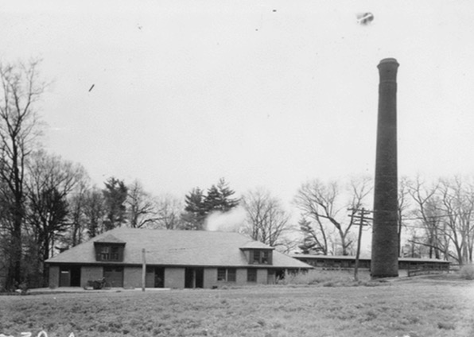
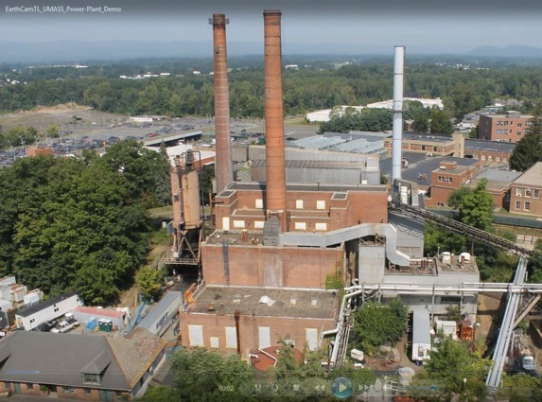
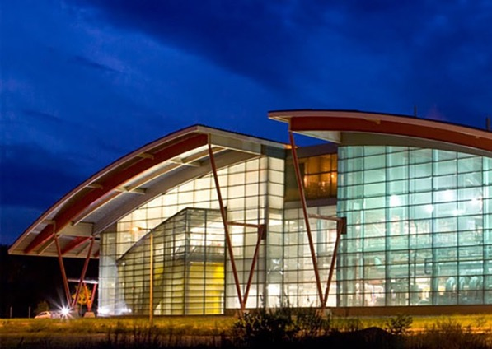
2. SUPPORT INSTITUTIONAL DIRECTION
Case study:
Energy transitions over time
2B. IDENTIFY HOW PAST INFRASTRUCTURE PROJECTS WERE PRIORITIZED AND IMPLEMENTED
2C. LINK CARBON-NEUTRAL OPERATIONS WITH CAPITAL PLANNING NEEDS
FIRST STEAM PLANT
(1910–1918)
COAL PLANT
(1918–2008)
CHP PLANT
(2009–PRESENT)
Notes:
Knowing where you have been (what decision from the past got to where you are now), is so helpful when trying to understand how to move into the unknown future. For UMass Amherst, understanding the decision points that drove them from steam, to steam with coal, to stem with natural gas, and helped them identify what resources, information, and leverage they need to engage to create the 4th energy transition for the campus—shifting from steam to low temp hot water, and from natural gas to electric.
That brings us to the third recommendation: create other benefits

Slide 13
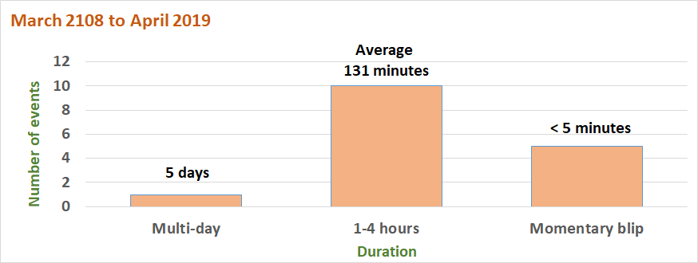
3. CREATE OTHER BENEFITS
Case study:
ANONYMOUS SCHOOL
Campus power failures and why addressing deferred maintenance matters
3A. ALIGN WITH DEFERRED MAINTENANCE
Compromised mechanical systems waste energy
Unanticipated system failures disrupt program
Notes:
Let’s start with creating benefits.
We saw great success at one school making a clear opportunity of the money that would be going into deferred maintenance in the next 10 years. Even though it doesn’t have and ROI on its own, neither does deferred maintenance.
This graphic summarizes campus power failures, directly linking future carbon neutrality work with ongoing issues.

Slide 14
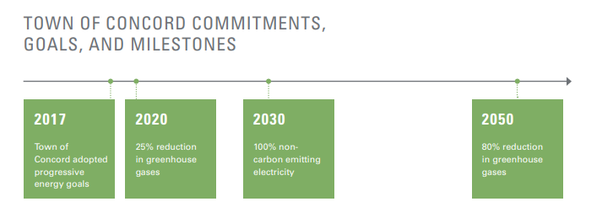
3. CREATE OTHER BENEFITS
Case studies:
Sustainability and climate action plans
3B. SUPPORT LOCAL, STATE, AND NATIONAL DIRECTIVES
Notes:
Concord Academy looked to local and state level programs and incentives to inform decision making for their carbon neutrality projects.
CA’s long terms goals are framed in aligned with the 2008 Massachusetts Global Warming Solutions Act for an 80% reduction by 2050.
Backing your strategies with established legislation can promote buy-in and encourage connectivity across efforts,

Slide 15
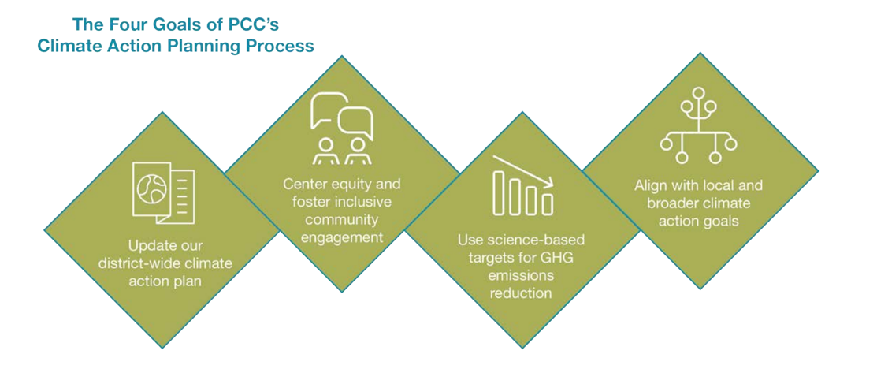
3. CREATE OTHER BENEFITS
Case study:
Climate action plan
3C. SHOW A BUSINESS CASE BEYOND ROI
Notes:
Portland Community College aligned their climate action plan with science-based targets, and they explicitly called out that addressing climate change in their operations is part of their charge as a community college - creating knowledge, jobs, and skills in the local economy, and that the enterprise business model for funding is dependent on them addressing the challenges of the future.

Slide 16
CREATE OTHER BENEFITS: SUMMARY
3A. ALIGN WITH DEFERRED MAINTENANCE
3B. SUPPORT LOCAL, STATE, AND NATIONAL DIRECTIVES
3C. SHOW A BUSINESS CASE BEYOND ROI
Notes:
Summary slide

Slide 17
SUMMARY
THREE TIPS:
KEEP IT SIMPLE — USE THE RULE OF THREE
1. ENGAGE STAKEHOLDERS
2. SUPPORT INSTITUTIONAL DIRECTION
3. CREATE OTHER BENEFITS
Notes:
Key messages are ultra-distilled, carefully crafted statements that emphasize the points you want to get across. In crisis communications when dealing with the media, we use key messages to ensure that all questions asked end up back to one or more of the key messages we’ve already developed. This helps us stay focused.
In communications, I think of connecting the dots as starting from a common place and very intentionally walking your audience to where you want to take them. This is important in storytelling: if you come out of left field, you’ll lose people. You really have to think about who you’re talking to and where they’re coming from. And because in this and many cases, your audience has multiple other priorities, you again want to be sure that you are addressing their concerns along with voicing yours.
The rule of three! Use Sesame Street example: “a loaf of bread, a container of milk, and a stick of butter.”

