Slide 1



THE
TAX-EXEMPT
LEASE PROGRAM (TELP)
AN ENERGY-EFFICIENCY PROGRAM FOR BOSTON-BASED NONPROFITS
PRESENTED BY
Notes:
Jen

Slide 2
Notes:
David

Slide 3


The Boston Industrial Development Financing Authority (BIDFA) promotes economic growth and employment in the City of Boston by issuing bonds that finance the capital needs of the city’s businesses and institutions.
Notes:
Bill

Slide 4
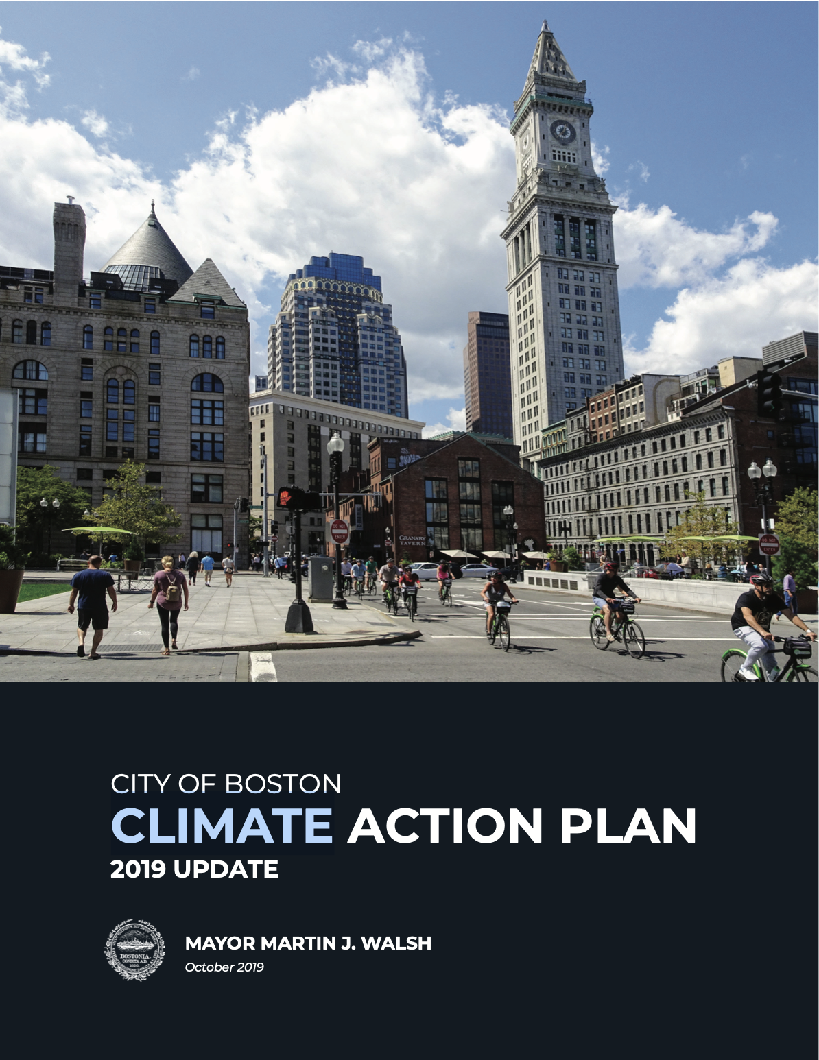
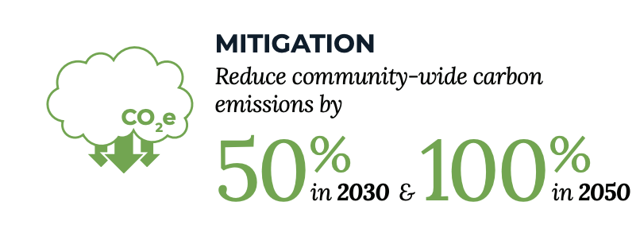


BOSTON CLIMATE ACTION PLAN
In 2019, Boston updated its climate action plan, identifying how it will reach the mayor’s goals for greenhouse-gas emissions reductions.
Notes:
Brenda

Slide 5
BERDO
The Building Energy Reporting and Disclosure Ordinance (BERDO) is Boston’s municipal legislation requiring that building owners report annual energy and water use.
It further requires buildings to complete a major energy savings action or energy assessment every five years.
In 2020, BERDO requires the following portfolios to report their annual energy and water usage for January 1, 2019 - December 31, 2019:
  Nonresidential buildings that are 35,000 square feet or larger
  Residential buildings that are 35,000 square feet or larger, or have 35 or more units
  Any parcel with multiple buildings that sum to 100,000 square feet or 100 units
Notes:
Brenda

Slide 6
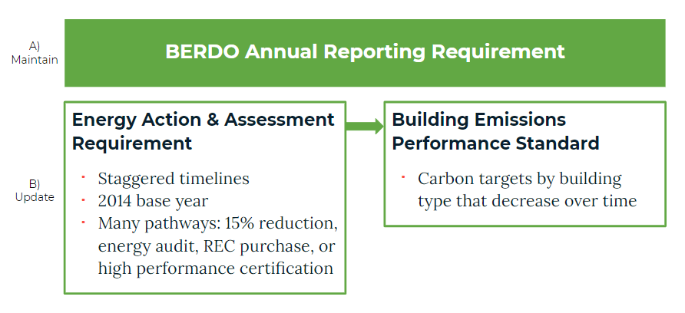
BERDO UPDATE
Notes:
Brenda

Slide 7
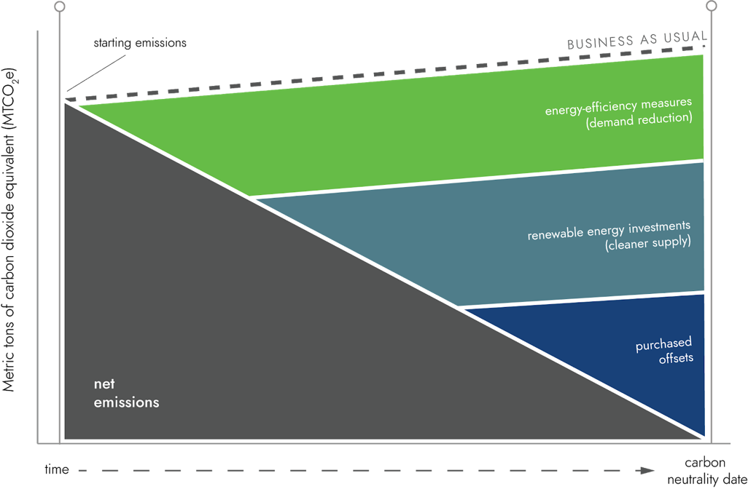
EMISSIONS REDUCTION OPTIONS
There are three basic paths to reducing greenhouse gas emissions within institutions responsible for owning and operating buildings:
reduce demand
buy cleaner supply
purchase offsets
Notes:
David

Slide 8
DEMAND REDUCTION
First and foremost, limiting or reducing demand—i.e., requiring less energy to operate facilities—is the first step toward climate or carbon neutrality.
Demand reduction can include building equipment upgrades and optimization.
HVAC
BUILDING AUTOMATION /
CONTROLS
LIGHTING
Notes:
David

Slide 9
DEMAND REDUCTION: ADDITIONAL BENEFITS
Done properly, building equipment upgrades or replacements can come with additional benefits:
increased occupant comfort and productivity
better equipment functionality
lower operational and maintenance costs
HVAC
BUILDING AUTOMATION /
CONTROLS
LIGHTING
Notes:
David

Slide 10
THE CHALLENGE
While there are benefits all around…
…there is the challenge of first costs.
Notes:
David

Slide 11

TAX-EXEMPT LEASE PROGRAM
Tax-exempt qualification from the Boston Industrial Development Financing Authority (BIDFA)
Financing from qualified lenders
Eligibility for Boston-based 501(c)(3) building owners
Nonprofits can enter into a performance contracting agreement with an energy service company (ESCO)
Repayment plans can be up to 20 years with the lowest available interest rates
Notes:
Bill

Slide 12


HOW IS THIS PROGRAM FUNDED?
program administrator
(conduit issuer of tax-exempt debt)
qualified lender
energy-savings project implementer
client
institution
+
utility incentives
upfront capital
$
Notes:
Bill (David might weigh in)

Slide 13
TELP BASIC STRUCTURE
Up-front capital for Boston institutions
Implementation of energy-efficiency improvements
Long-term energy savings
Long-term cost savings
Notes:
David

Slide 14

HOW DOES IT WORK?
$$$
$$$
$$
Identify eligible projects
Develop and implement selected projects
Institution sees full benefits of ongoing energy cost savings
Up to 20-year finance term; savings are guaranteed to exceed payments
Notes:
David

Slide 15
WHO IS ELIGIBLE?
private colleges and universities
independent (private) schools
museums and performing arts institutions
other 501(c)(3) institutions
B O S T O N
Notes:
Bill

Slide 16
WHAT’S THE PROCESS?
Stage | Month
 | 1 | 2–7 | 8 | 9–23 | 24
Initial meeting
Sign project development agreement
Develop proposal
Sign efficiency supply contract
Implement project
Begin saving
Notes:
David / maybe also Bill

Slide 17

ALTERNATIVE FINANCING OPTIONS
CPACE
BENEFACTOR
INVESTMENT
MODEL
Notes:
David (waiting on response from Brenda re: CPACE in Boston)

Slide 18
Q&A
Notes:
Jen

Slide 19


FOR MORE INFORMATION
DAVID ADAMIAN
President & CEO, GreenerU
617-905-7589
david.a@greeneru.com
BILL NICKERSON
Executive Director, BIDFA
617-918-6262
bill.nickerson@boston.gov

